Slide 1
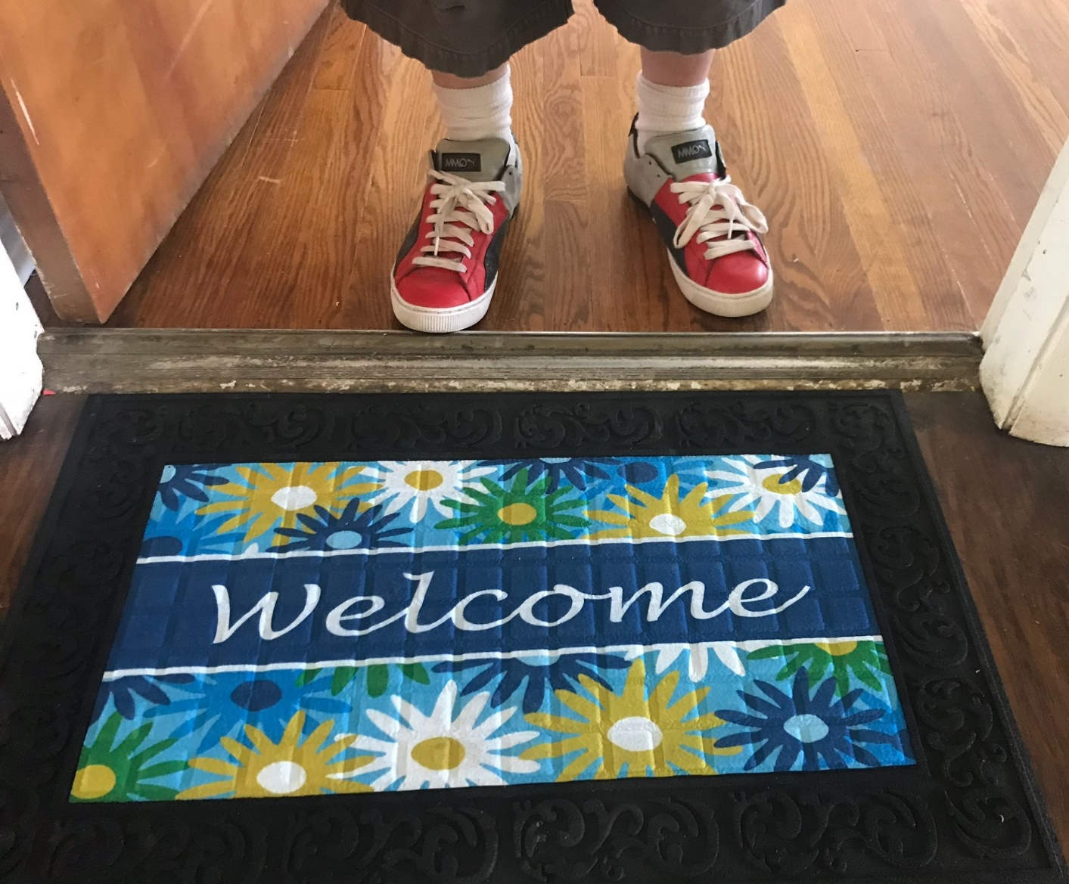
Horizon House
Supportive Housing
Program
Lillian Herbers-Kelly, LMSW
Housing Program Manager
April 27, 2021
Notes:
Horizon House is a multi service daycenter with showers, laundry, triage case management, employement services, and a dedicated medical and mental health center

Slide 2
Housing Process/Overview
Horizon House receives referral from Coordinated Entry
Housing team engages, offers supportive services, and completes intake
Application for Section 8 voucher is completed
Participant attends orientation at Indiana Housing Agency and receives voucher
Supportive housing search begins with housing team
Housing navigator completes property inspection
Upon Successful Inspection, lease signing is scheduled
Participant transitions into their home
Housing team assists with household supplies and furnishings
Notes:
We are the Service Delivery Entity that is responsible for providing intensive case management and housing navigation for individuals experiencing homelessness that come through the Coordinated Entry System and are matched with a homeless preference voucher through Indiana Housing Agency. We serve individuals who have been homeless a long time and often have barriers to housing like criminal history and evictions.
This is just a visual of our process as it relates to our largest housing program.

Slide 3
Collaborative Relationship IHA
What has worked:
-Program letter
-Support letter for mitigating circumstances
-Monthly scheduled staffings
-Continued work on barriers for individuals with criminal history
-Advocacy within housing
Notes:
Because our clients are matched with a Housing Choice Voucher, a lot of our advocacy starts with making sure they are approved for a voucher. We have been successful in this area in a number of ways.

Slide 4
Scattered Site Model
Participant
Property/Landlord
Client choice is paramount with scattered site
“Grouping” individuals
Focus on relationship building during housing search
Lease Education
Weekly contact, regular home visits
Keys to the buildings
Open communication with landlords
Scheduled “check ins”
Present at lease signing
Provide case manager contact information

Slide 5
Landlord Recruitment and Retention
Landlord letter explaining our program
Landlord appreciation efforts
Cold calls
Stopping in (changed with COVID)
Building relationship over time (for new ones)
Support letter
Start with one client

Slide 6
Contact Information: lillianh@horizonhouse.cc 317-423-8909 ext 329

